Slide 1

Predicting the compressive strength of concrete
Using machine learning
Developed by : Azma Mohammed , Anna Priyanka,
Akula Rahul , Chinnala Madhukar

Slide 2
Table Contents
INTRODUCTION
ADVANTAGES AND DISADVANTAGES
APPLICATIONS
CONCLUSION

Slide 3
Introduction
Concrete is the most widely used building material around the world due to its various advantages over other materials, e.g., integrity, durability, modularity, economy, etc.
concrete is made up of different components, e.g., coarse/fine aggregates, cement pastes, additional mixtures, etc., and these components are randomly distributed over the entire concrete matrix. Such a complicated system makes it a great challenge to accurately predict the compressive strength of concrete material.
it is a trend to use machine learning (ML) techniques to predict the concrete compressive strength. ML is a branch of AI, and can be used for several objectives, e.g., classification, regression, clustering, etc. Predicting concrete compressive strength is just one application of the regression function of ML
. Compared with other traditional regression method, ML adopts certain algorithms that can learn from the input data themselves and gives highly accurate results for the output data, which shows an obvious advantage over the traditional regression methods

Slide 4
PURPOSE
According to the evaluation metrics, such as the correlation coefficient, root mean squared error, and mean absolute error, the fuzzy logic method makes better predictions than any other regression method.
Our aim from the project is to make use of pandas, matplotlib, & seaborn libraries from python to extract the libraries for machine learning for the predicting compressive strength of concrete.
Train the model by using machine learning algorithms and in the end, to predict the compressive strength of concrete using voting ensemble techniques of combining the predictions from multiple machine learning algorithms and withdrawing the conclusions

Slide 5
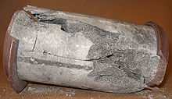
Existing Problem
The previous models have high time complexity and space complexity whereas this model is constrained with the lot of advantages and with a higher accuracy than any other model already proposed’
there is an user friendly user interface to check the compressive strength of concrete ,and lot of the previous models haven't included the UI (User interface) which is so friendly and convenient for the users.

Slide 6
Proposed Solution
Machine learning(Random Forest):
Using a Decision Tree Regressor has improved our performance, we can further improve the performance by assembling more trees. Random Forest Regressor trains randomly initialized trees with random subsets of data sampled from the training data, this will make our model more robust.
Random forests are an ensemble model of machine learning with their roots in Decision Trees. These decision trees individually may over fit the data set and thus they come together to form a much stronger model. Numerous decision trees are first built and based on these by performing random sampling of the attributes a group of decision trees are assembled to form a Random Forest.

Slide 7
Block Diagram
Data set collection
Data
pre-processing
check missing values
Data visualization
testing the model
Train and Test the Data
Splitting data
Incorporate with Html and Flask
Deployment

Slide 8
Software Designing
Jupyter notebook environment
Spyder ide
Machine learning algorithms
Python
HTML
Flask

Slide 9
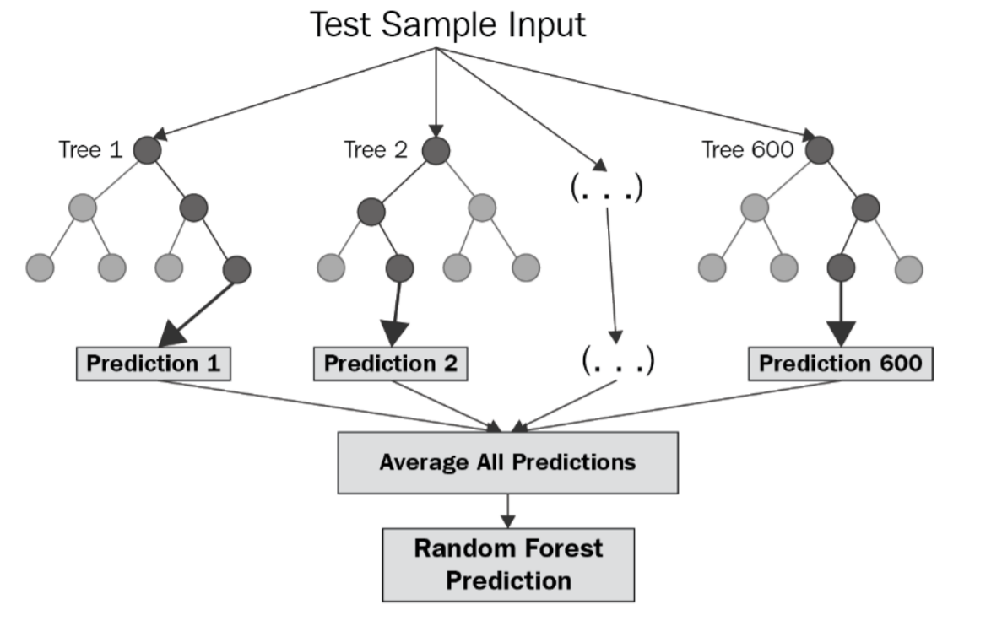
FLOW CHART

Slide 10
RESULT
In this paper, the Random Forest Regression algorithm is used to predict its performance, and compared with another three machine learning methods namely the Multi regression, decision tree, and the ANN Algorithm.
The obtained results are displayed in Table below .
The results show that, the performance of Random forest have comparable performance than that of multi regression, ANN and decision tree, so the Random still performs the best, with an accuracy of 92%, higher than remaining algorithms.
ALGORITHM USED | ACCURACY
multi regression | 63%
decision tree | 78%
Random Forest | 92%
ANN | 82%

Slide 11
ADVANTAGES AND DISADVANTAGES
Advantages:
Easy and simple User Interface for the people who is going to evaluate the concrete strength.
Random forest give the accurate result of the prediction upto 92% which is the algorithm we used for prediction
It is widely used for prediction of compressive strength of concrete.
It is composed using the HTML and Python for the web usage in real time
Disadvantages
Gives only 92% accuracy for the concrete strength prediction
Although random forest can be used for both classification and regression tasks, it is not more suitable for Regression tasks.

Slide 12
Applications
It is widely used for predicting the compressive strength of concrete and mainly used in constructions.
while preparing concrete it is hard to take how much water and ash etc., to prepare it and finding it's compressive strength.
The prediction results of concrete compressive strength based on machine learning methods are seriously influenced by input variables and model parameters.

Slide 13
CONCLUSION
We have analyzed the Compressive Strength Data and used Machine Learning alorithm to Predict the Compressive Strength of Concrete.
Random Forest Regressor has the lowest RMSE,highest accuracy and is a good choice for this problem.
Also, we can further improve the performance of the algorithm by tuning the hyperparameters by performing a grid search or random search.

Slide 14
“CONCRETE COMPRESSIVE STRENGTH IS A KEY PARAMETER IN DESIGN AND EVALUATION”

Slide 15
THANK YOU!

